Slide 1
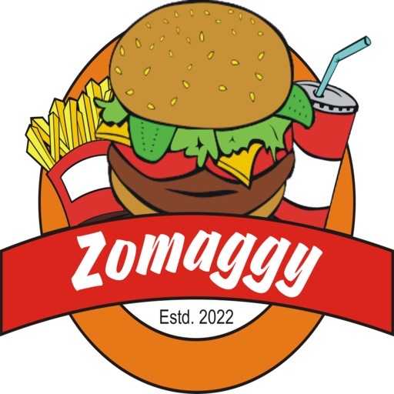

Slide 2
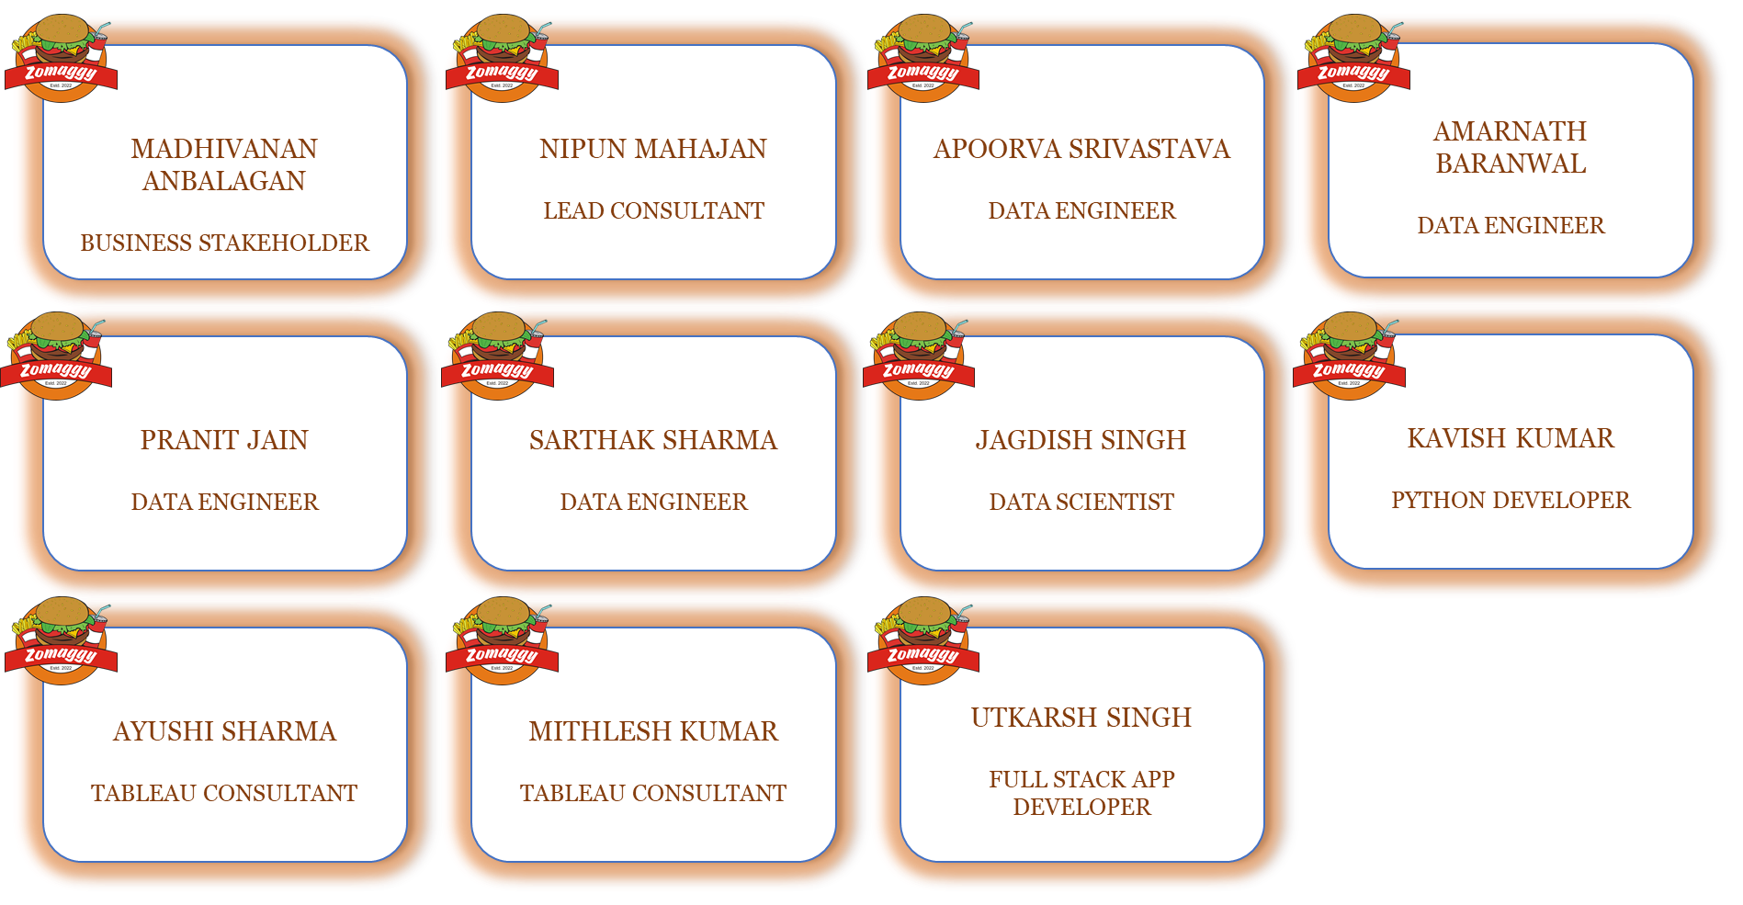
OUR
TEAM

Slide 3
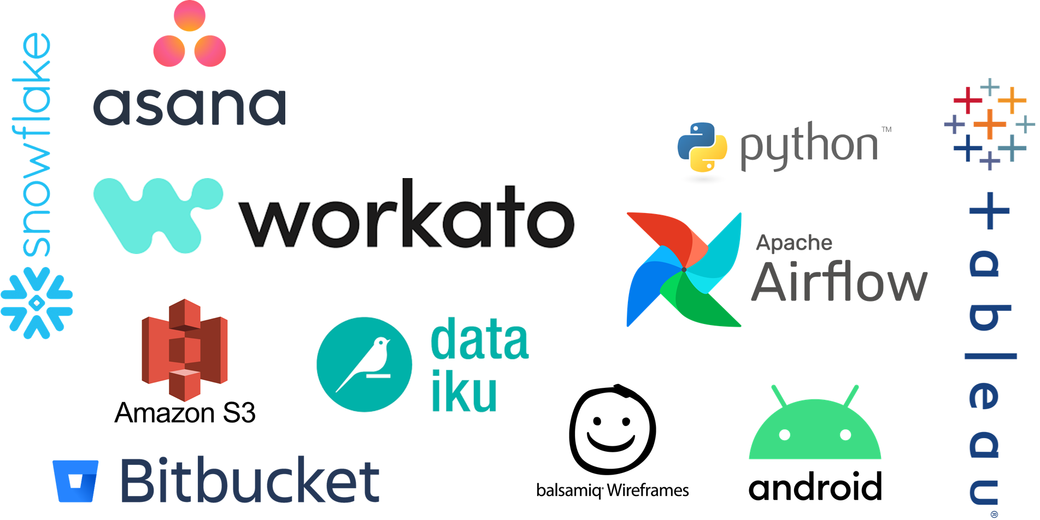
TECH STACK USED

Slide 4
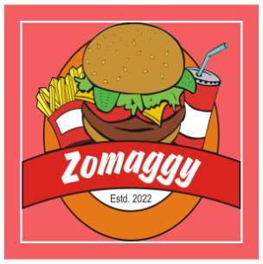
Architecture

Slide 5
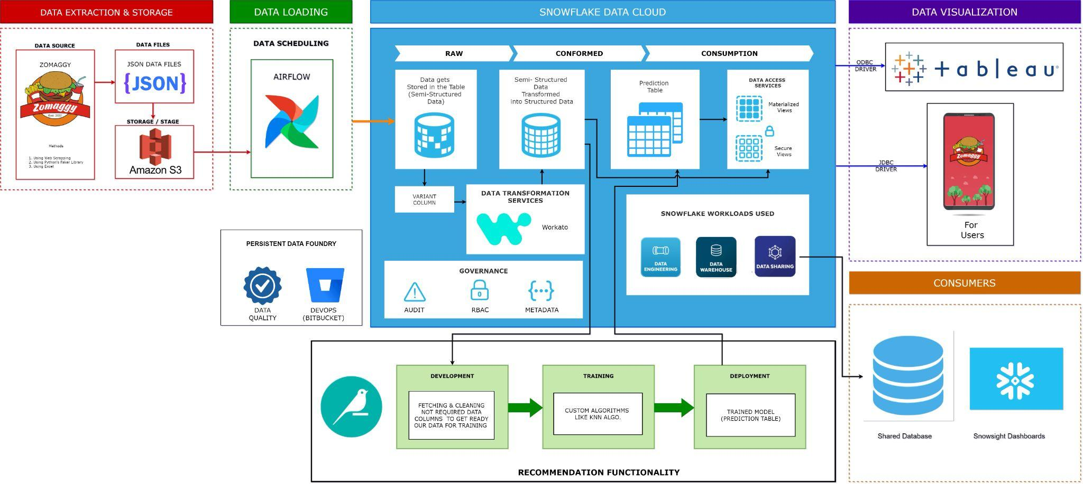
Architecture

Slide 6
Data Extraction
Backend team of Zomaggy is putting daily orders data in a S3 bucket in the form of JSON. From here the analytics team is extracting the data for further processing.

Slide 7
Data Generation
and Randomization
In order to generate data we are using faker library and excel. We are using different ways to generate the data and its randomization process
Using web scraping
Using faker library
Using excel

Slide 8
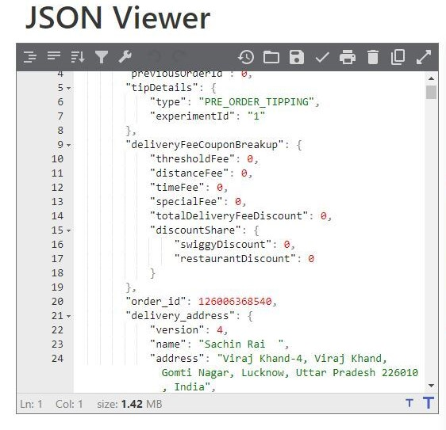
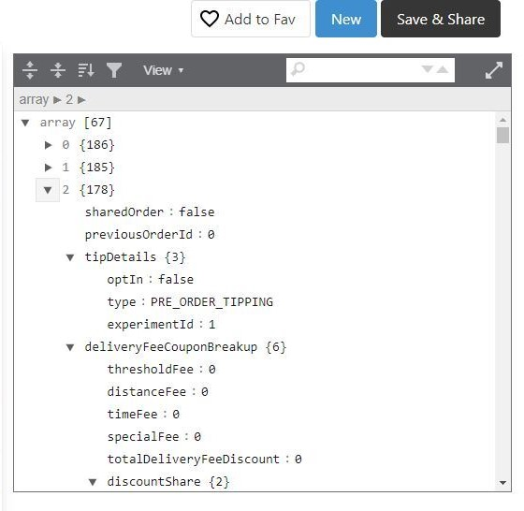

Slide 9
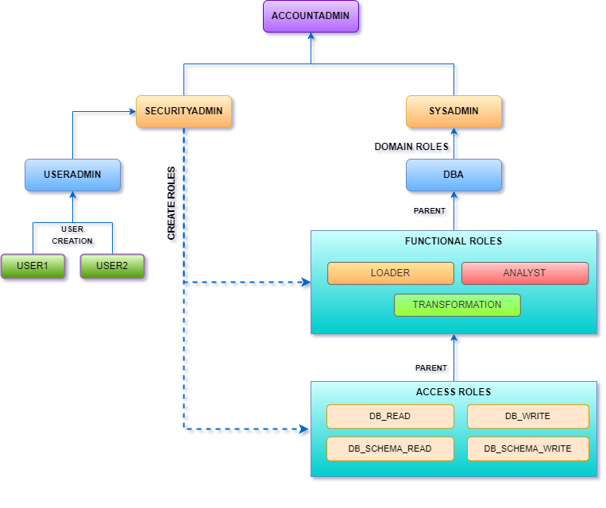
RBAC Hierarchy

Slide 10
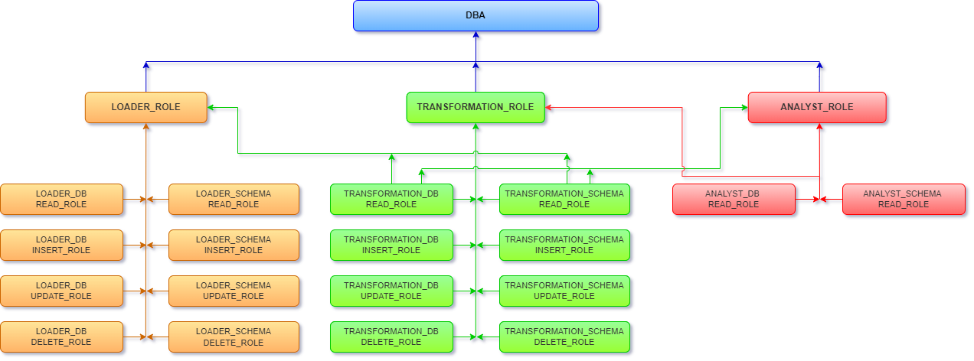
RBAC Hierarchy

Slide 11
Data Loading
Once the files are uploaded in the bucket the refresh happens using Airflow which is fetching these files from the bucket to Snowflake database.

Slide 12
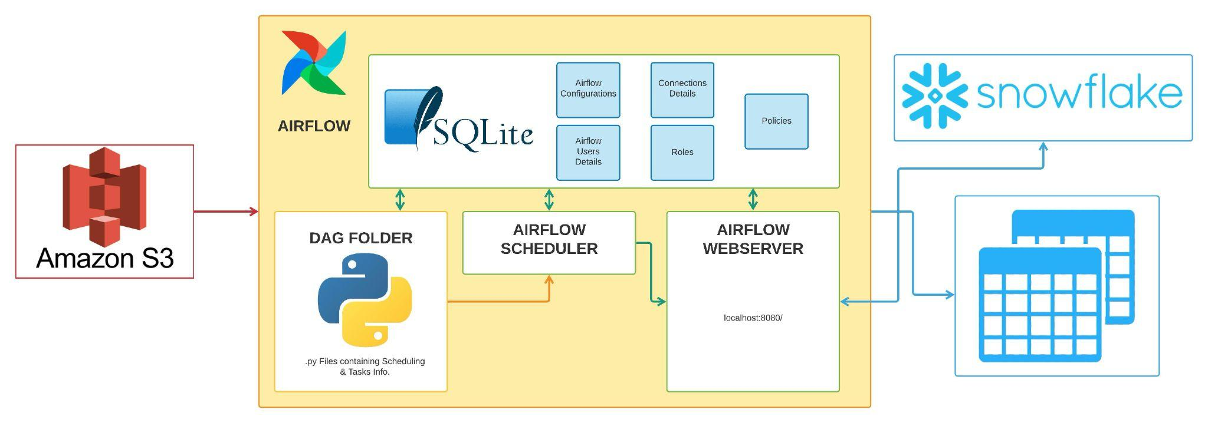
Airflow Architecture

Slide 13
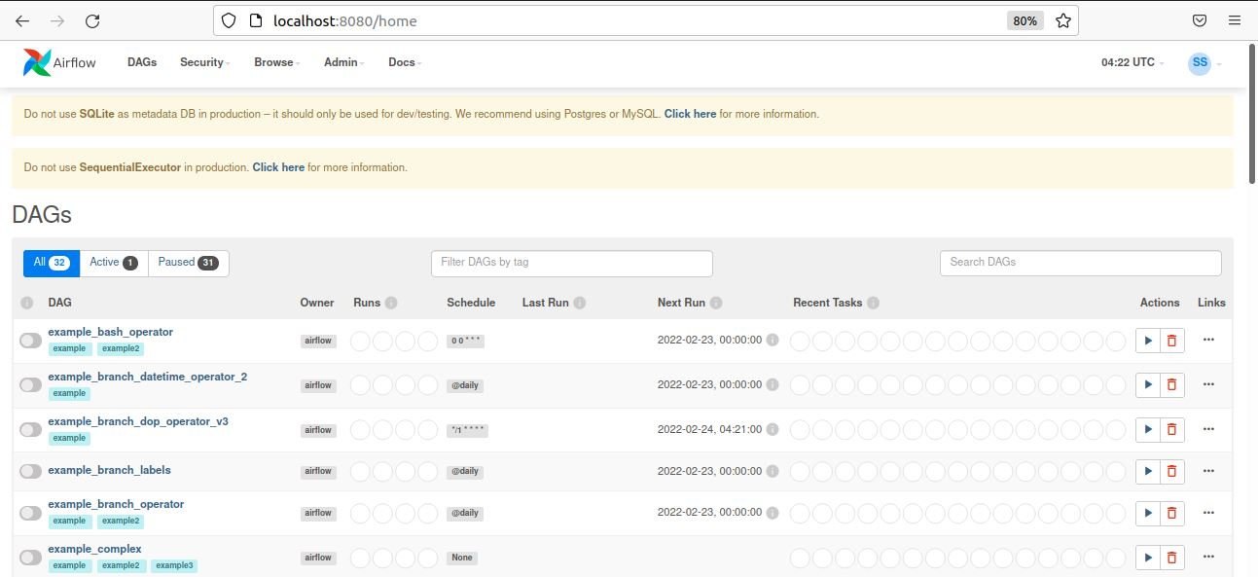

Slide 14
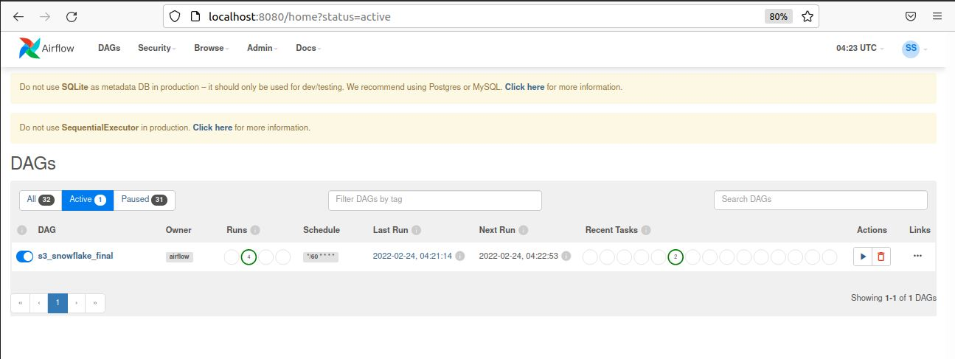

Slide 15
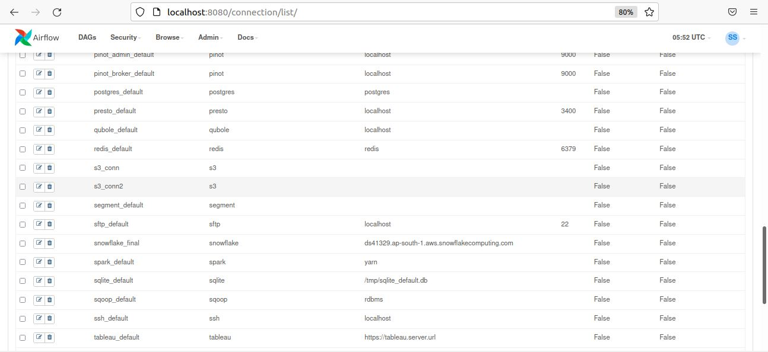

Slide 16
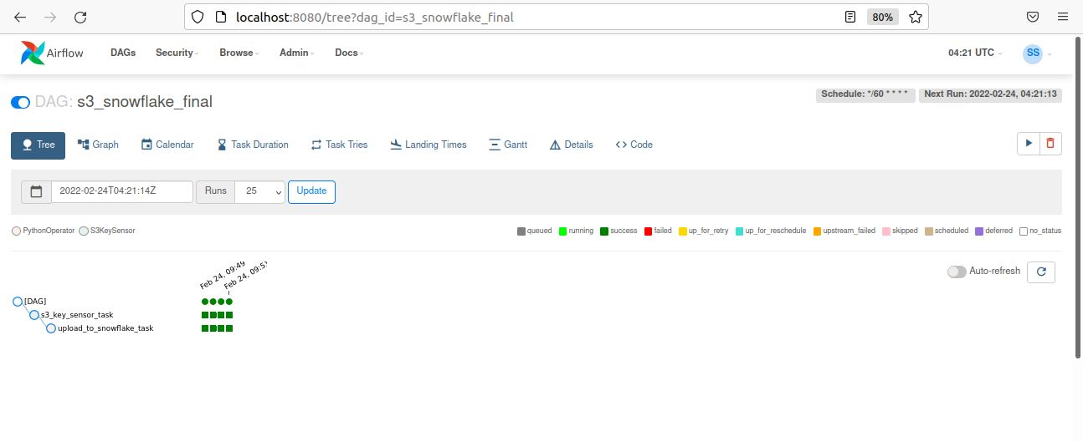

Slide 17
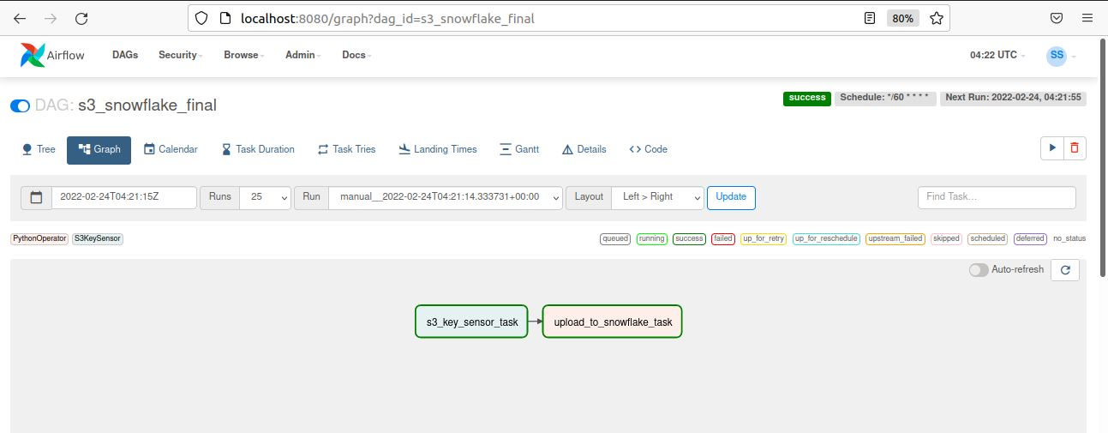

Slide 18
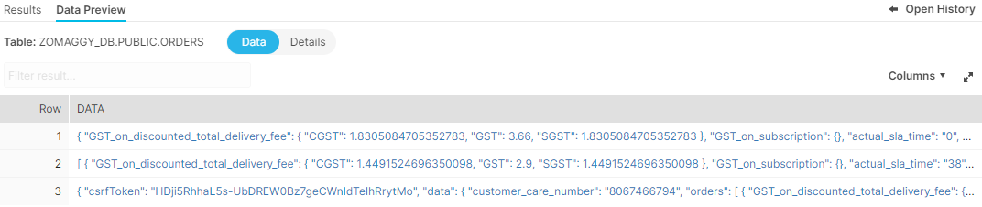
Semi-Structured Data Loading
Processed multiple data files using airflow which contain raw JSON data. Used VARIANT data type to persist semi structured data in a Snowflake Table.

Slide 19
Data Transformation
Using Workato the analytics team has put this semi structured data to a structured format in Snowflake database.

Slide 20
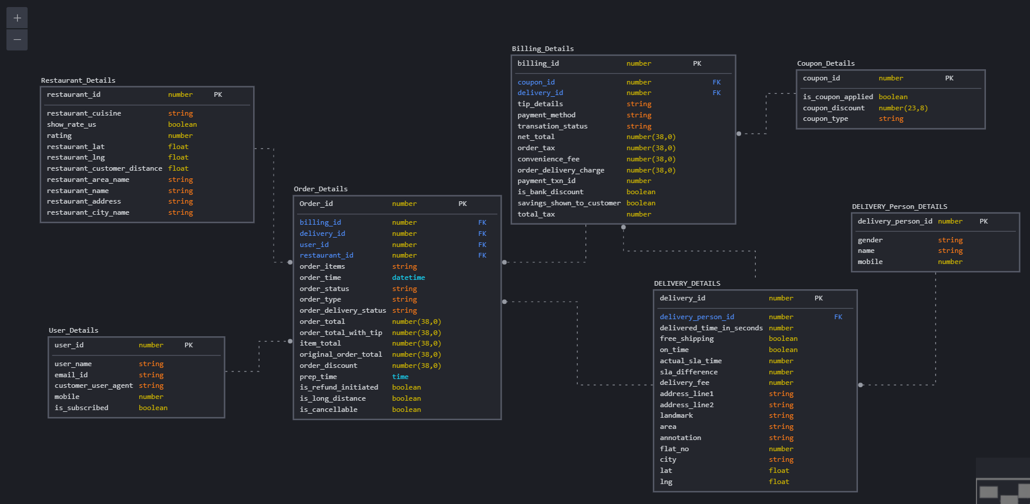
Database Model

Slide 21
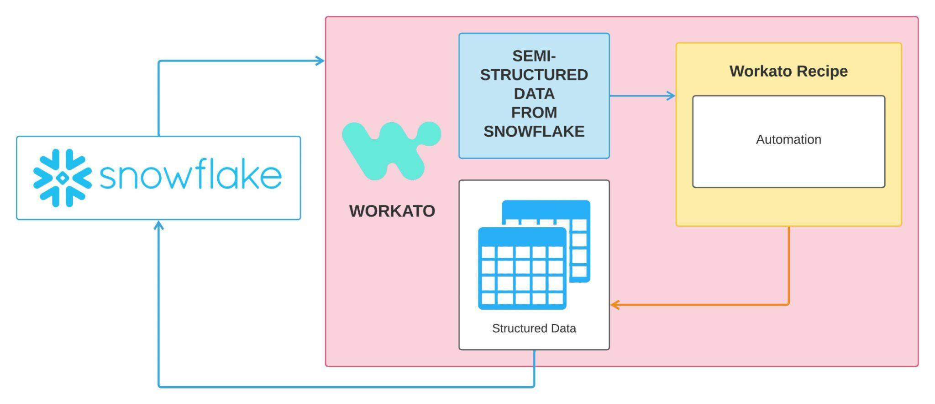
Workato Architecture

Slide 22
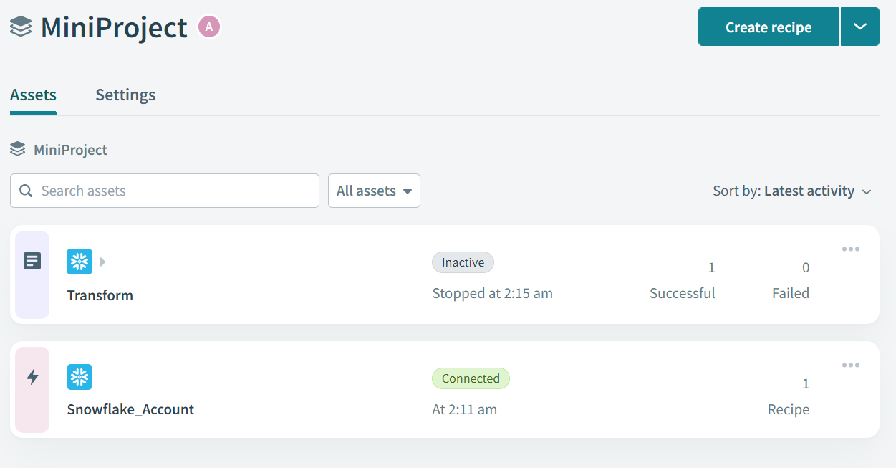

Slide 23
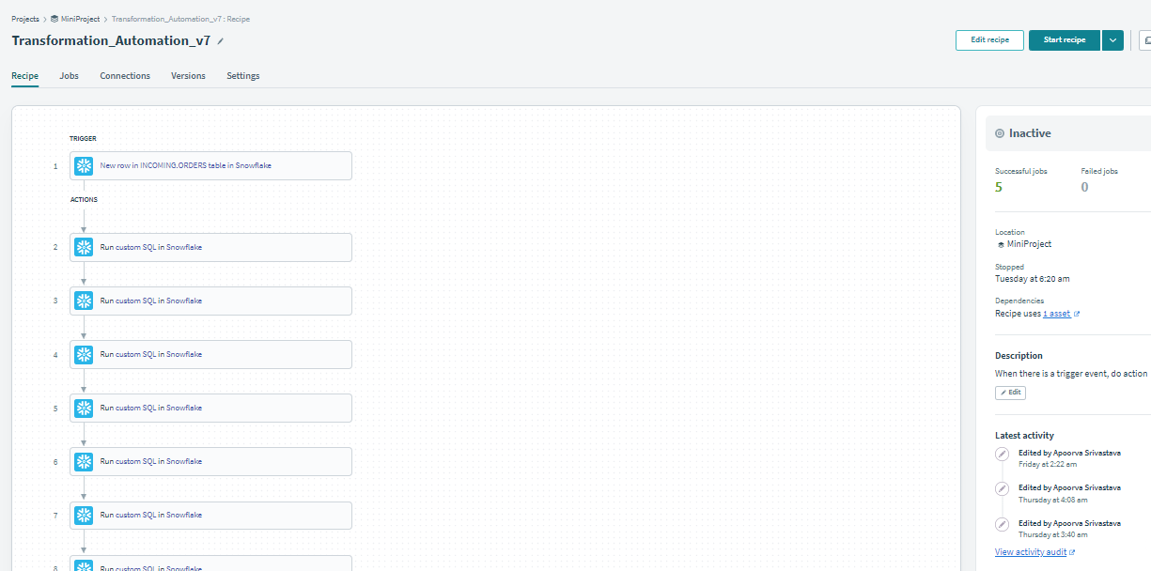

Slide 24
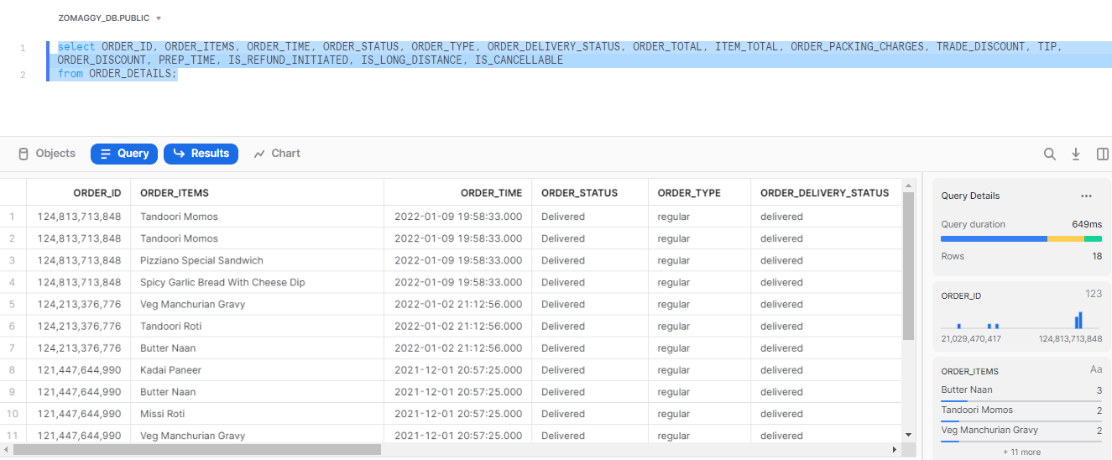

Slide 25
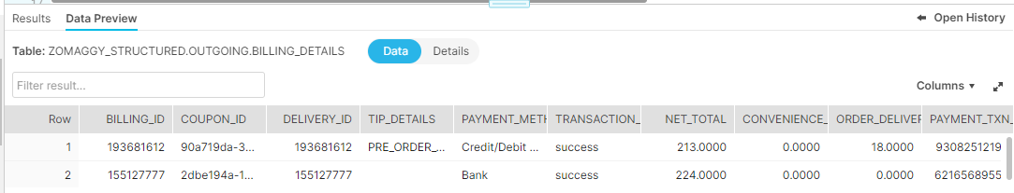
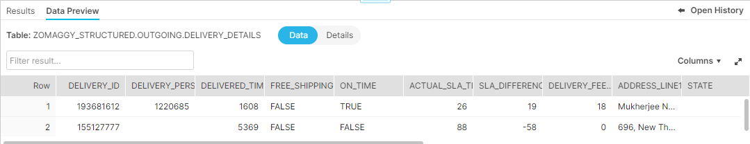
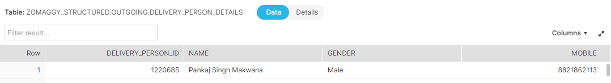

Slide 26
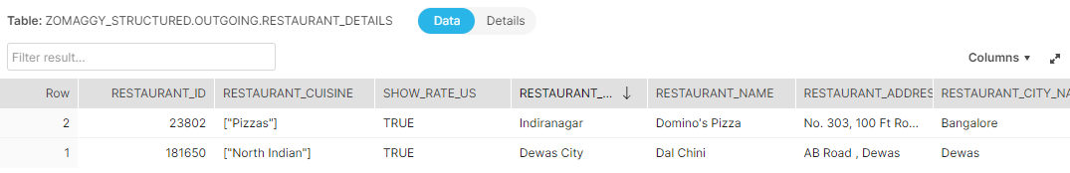
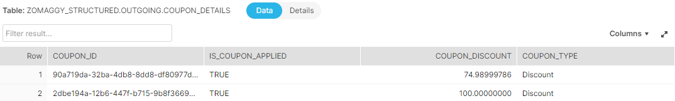
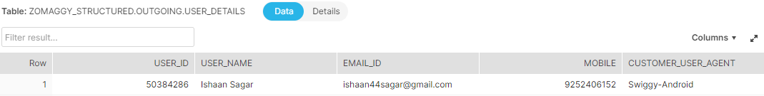

Slide 27
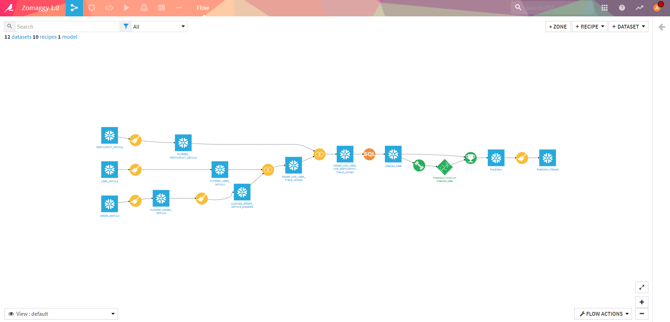
Dataiku

Slide 28
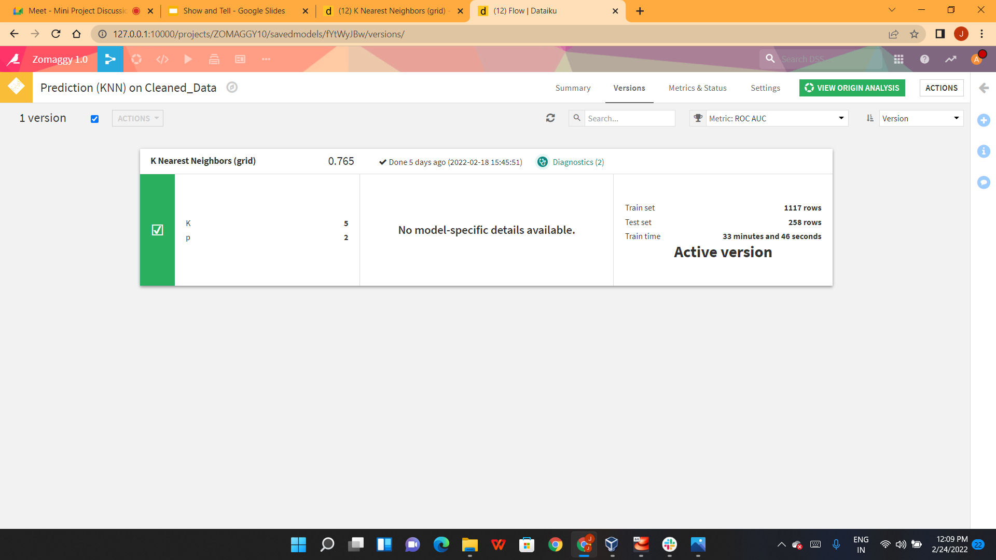
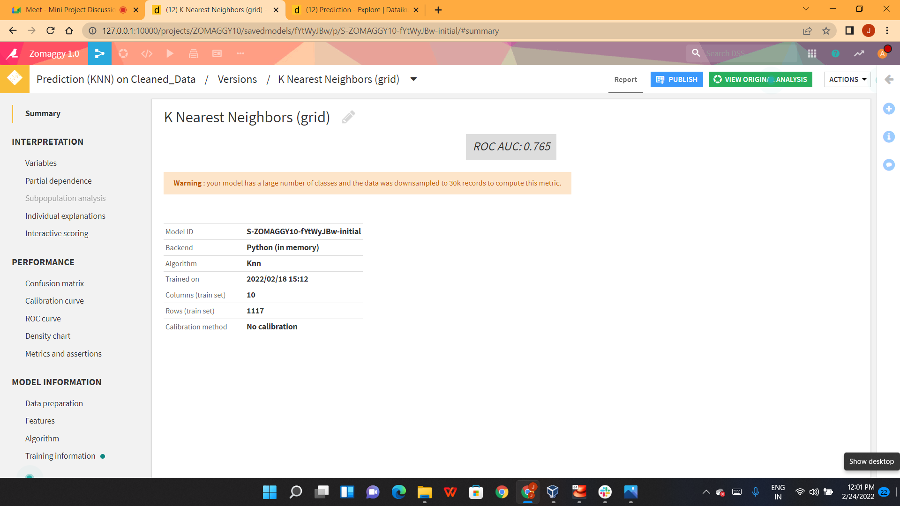
Dataiku

Slide 29
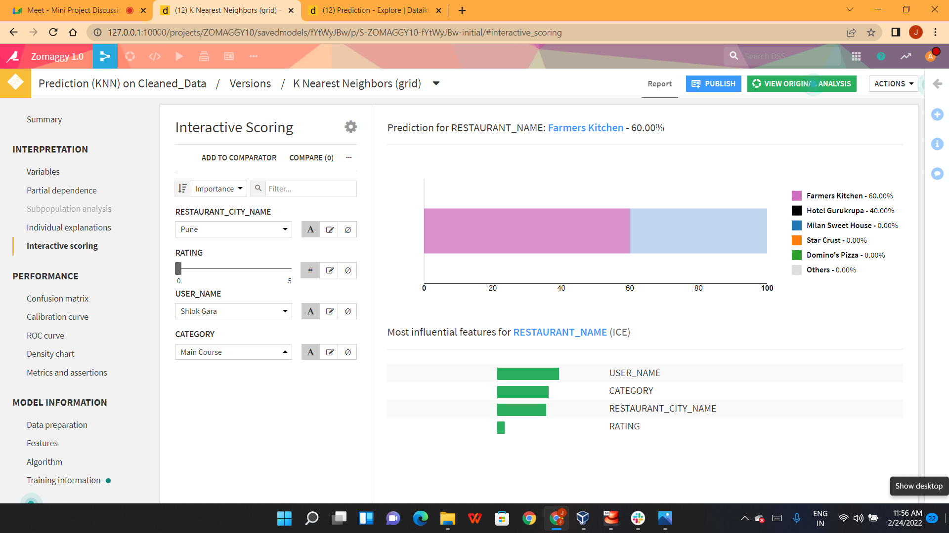
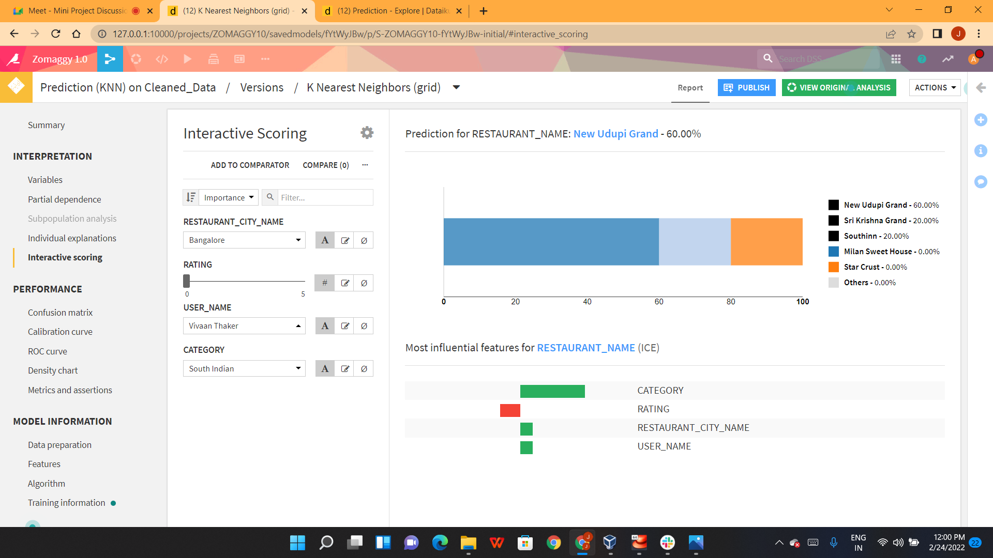
Dataiku

Slide 30
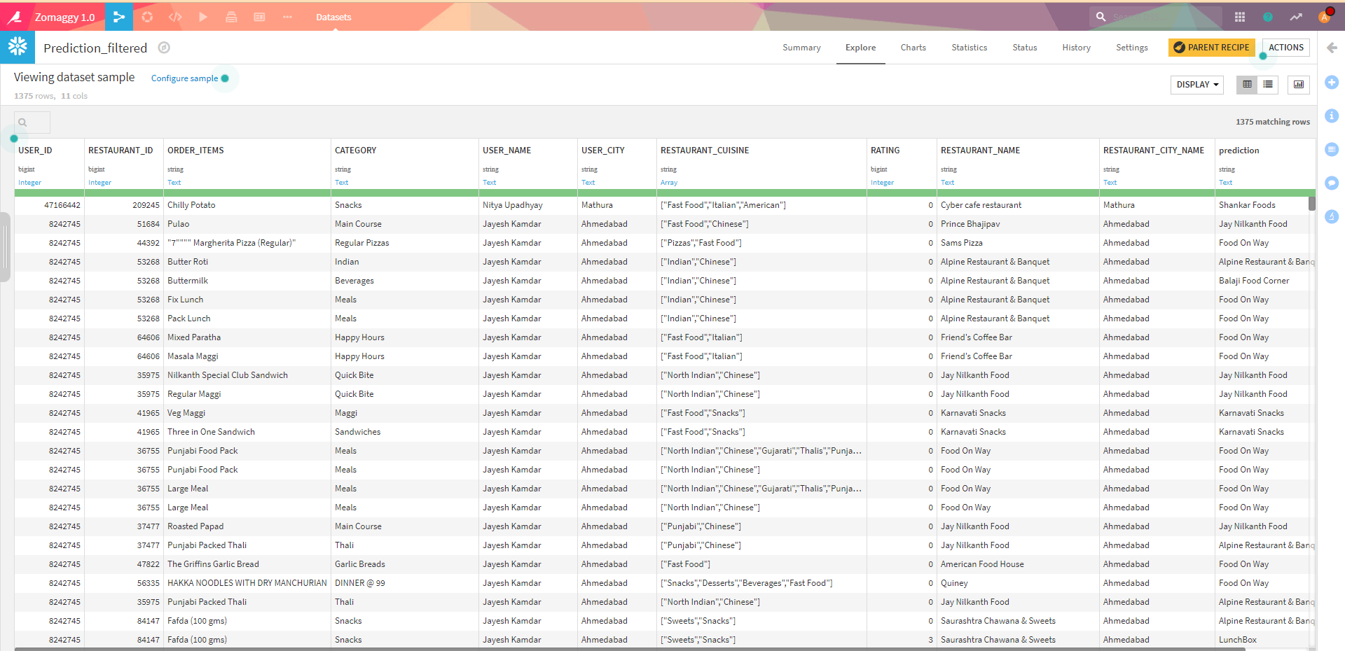
Dataiku

Slide 31
Data Visualization
Team is working on data visualization using Mobile App for Users, Tableau for Zomaggy and Snowsight for Restaurants. Implementing Balsamiq wireframe for creating blueprint of the app.

Slide 32
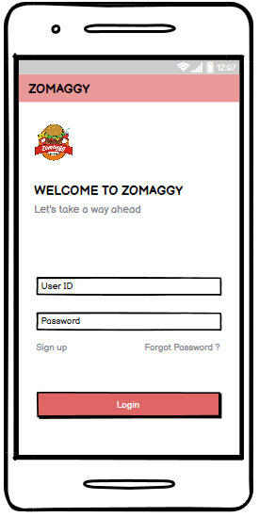
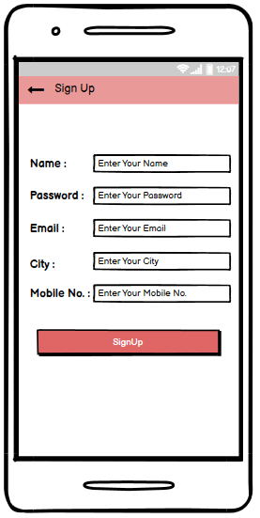

Slide 33
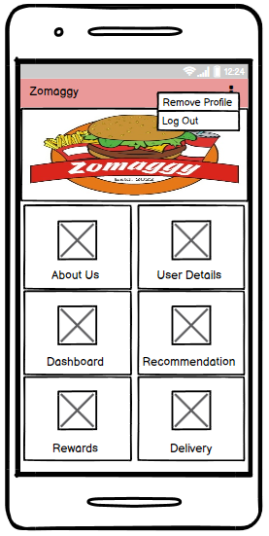
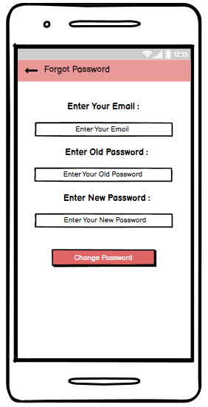

Slide 34
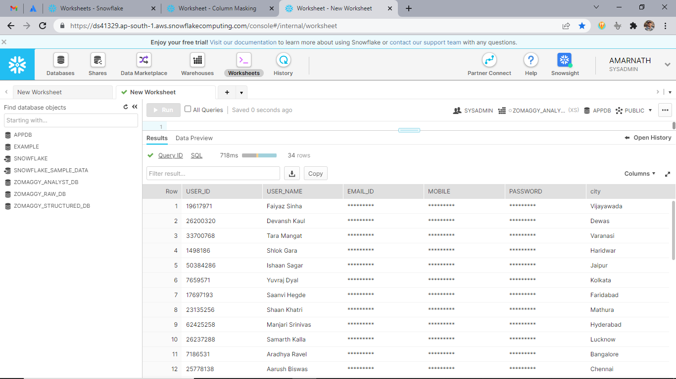
Data Masking

Slide 35
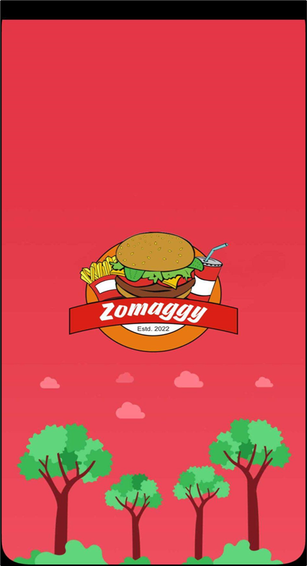
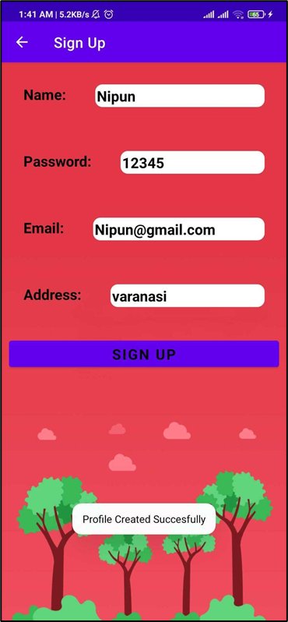
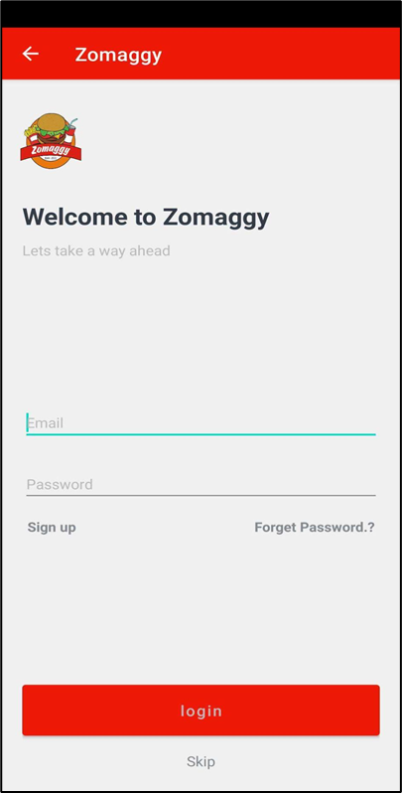
Notes:
App Demo

Slide 36
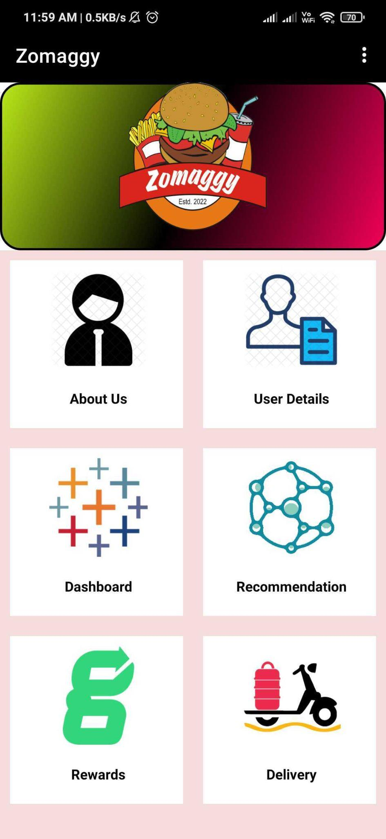
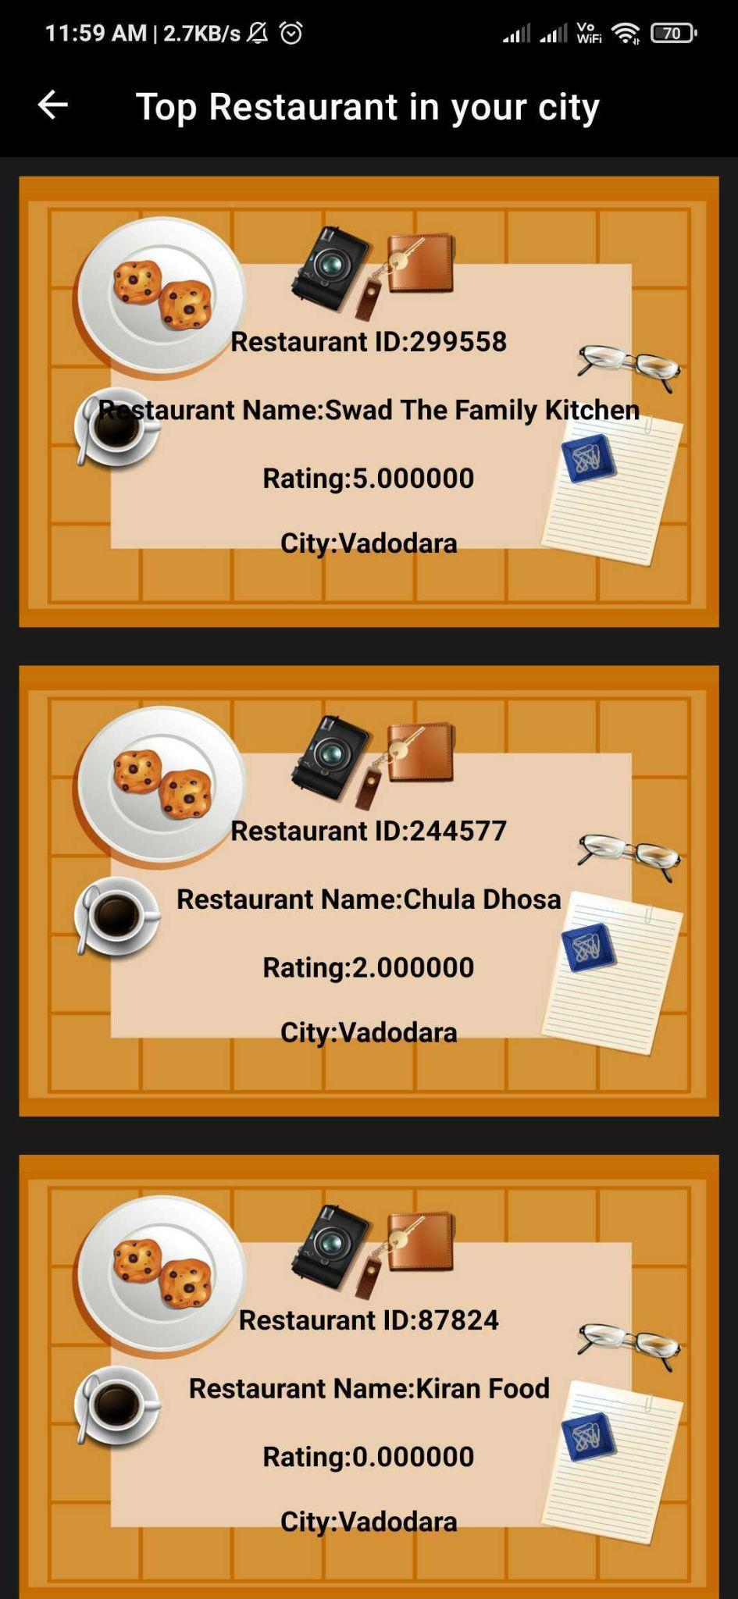
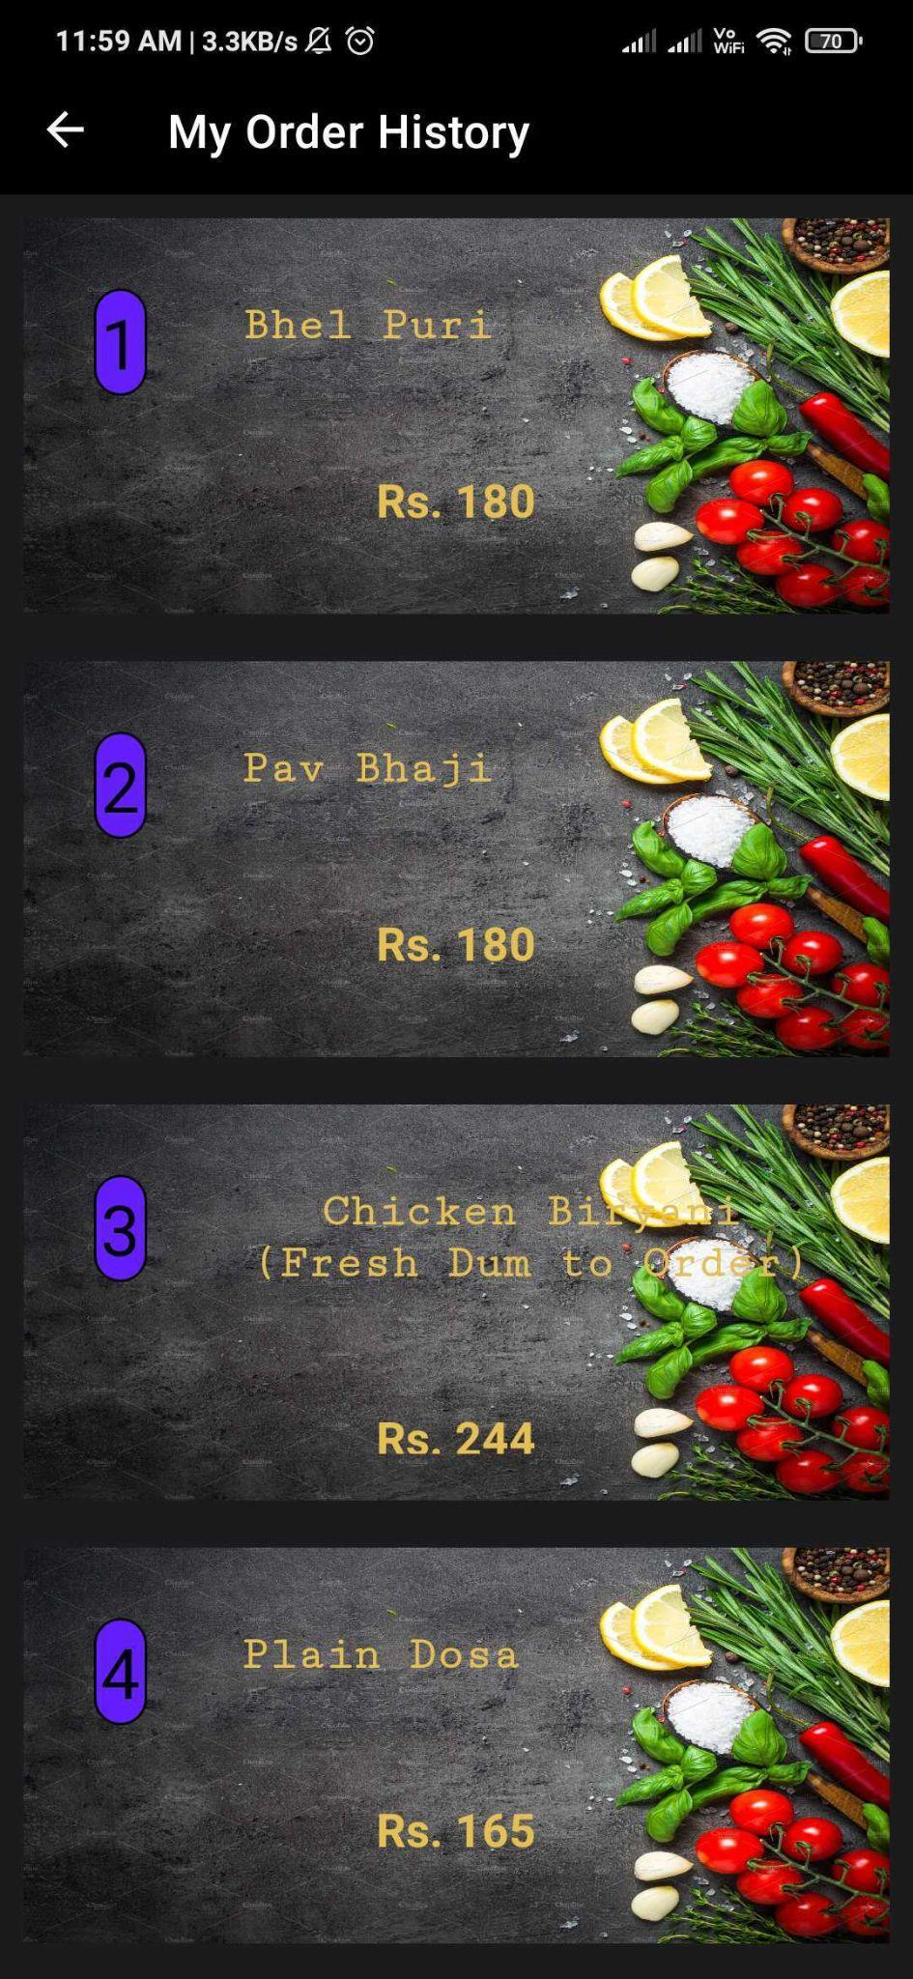

Slide 37
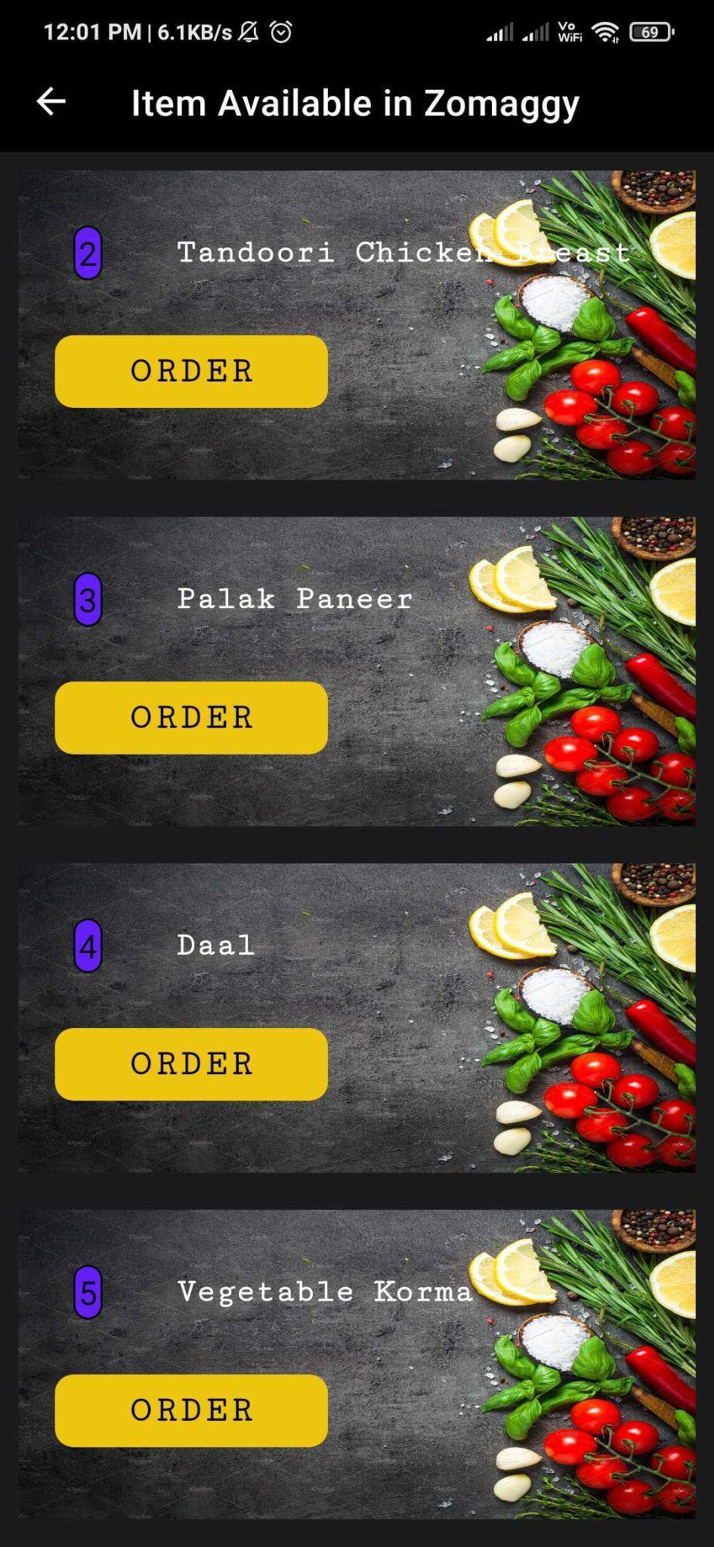
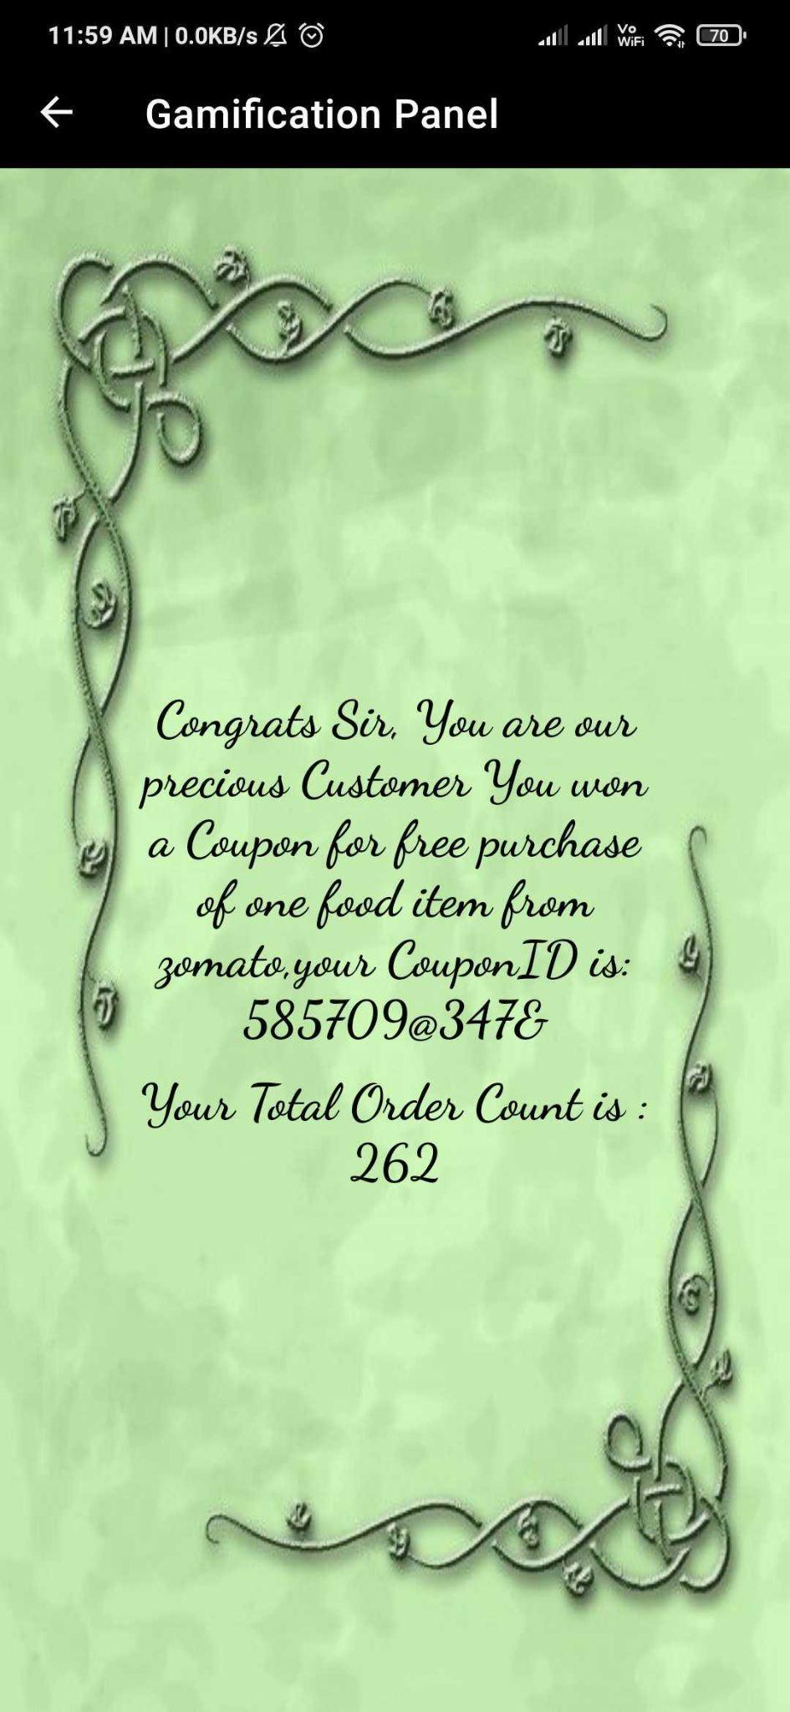

Slide 38
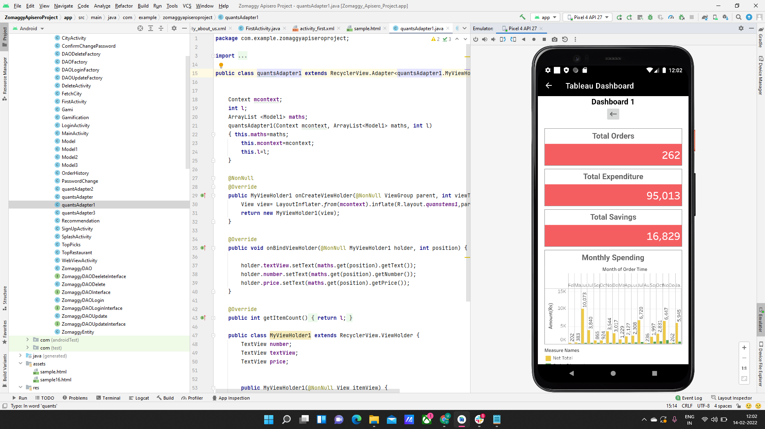
User Dashboard
Notes:
Tableau Demo

Slide 39
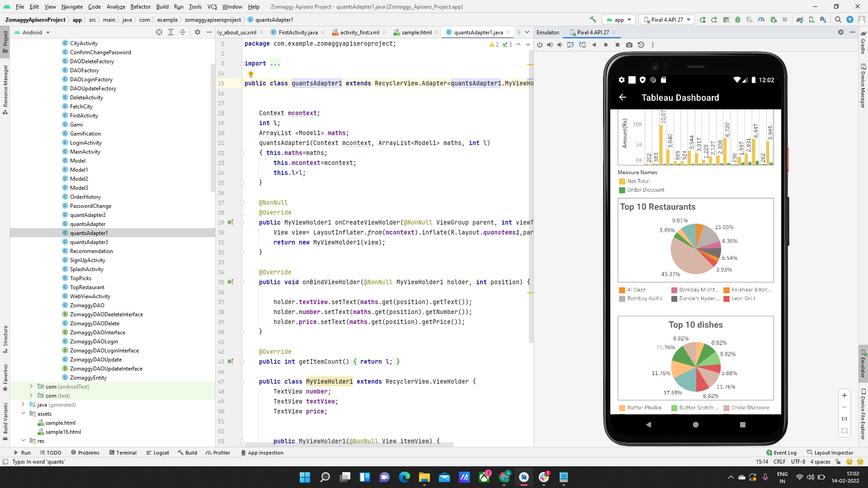

Slide 40
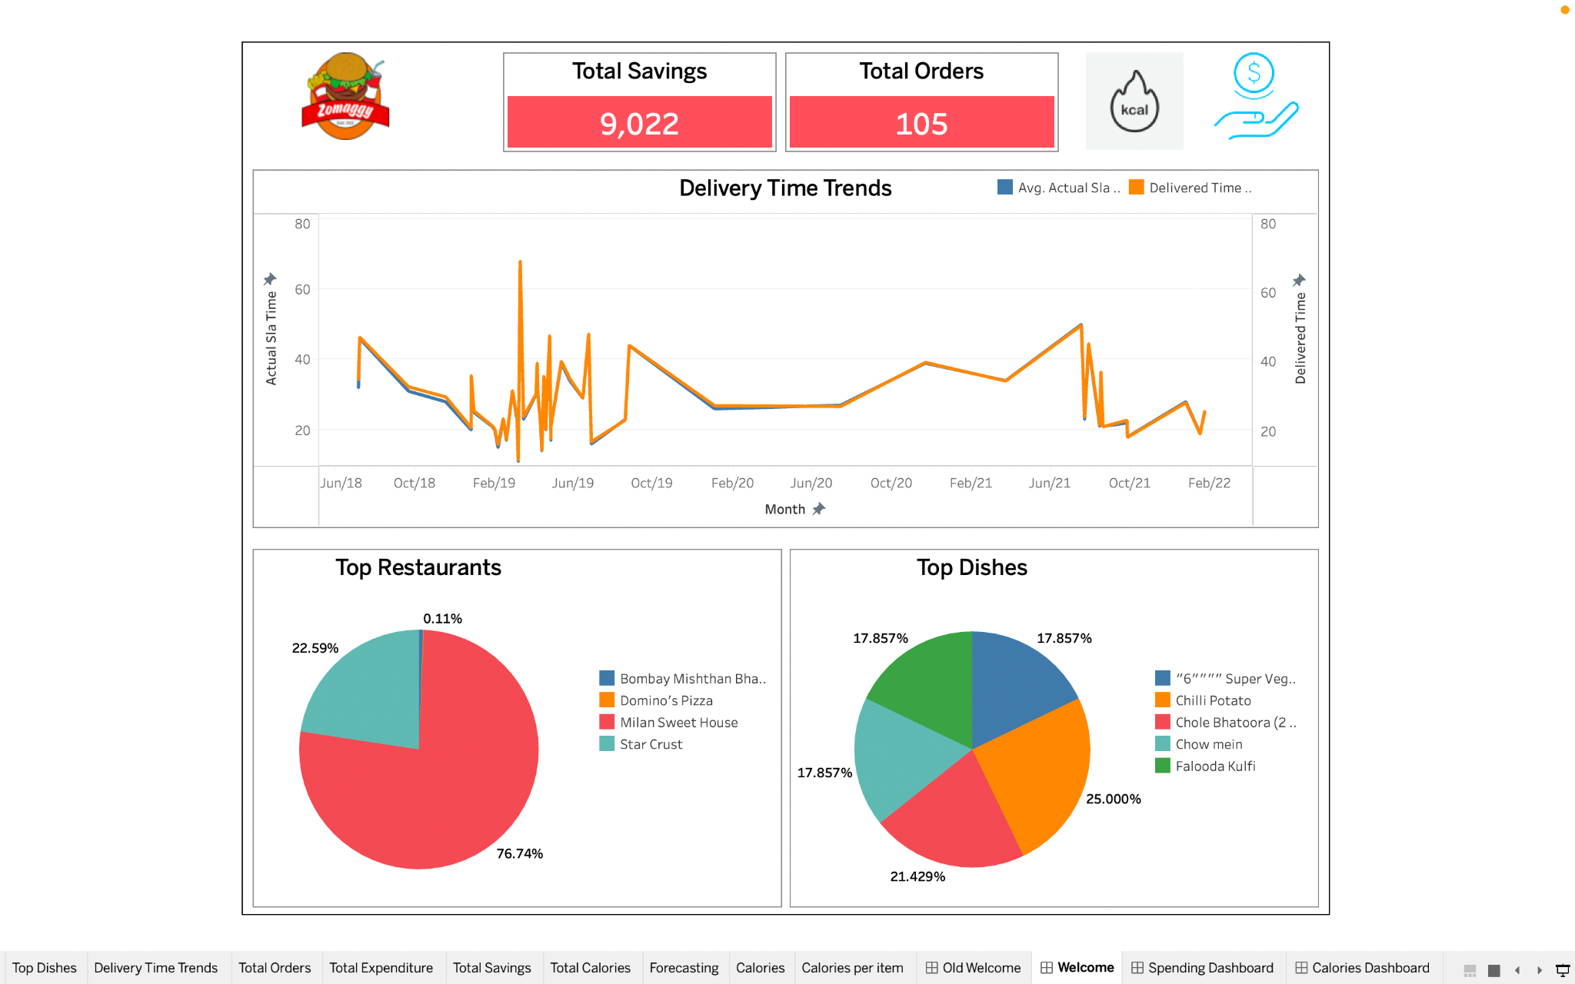

Slide 41
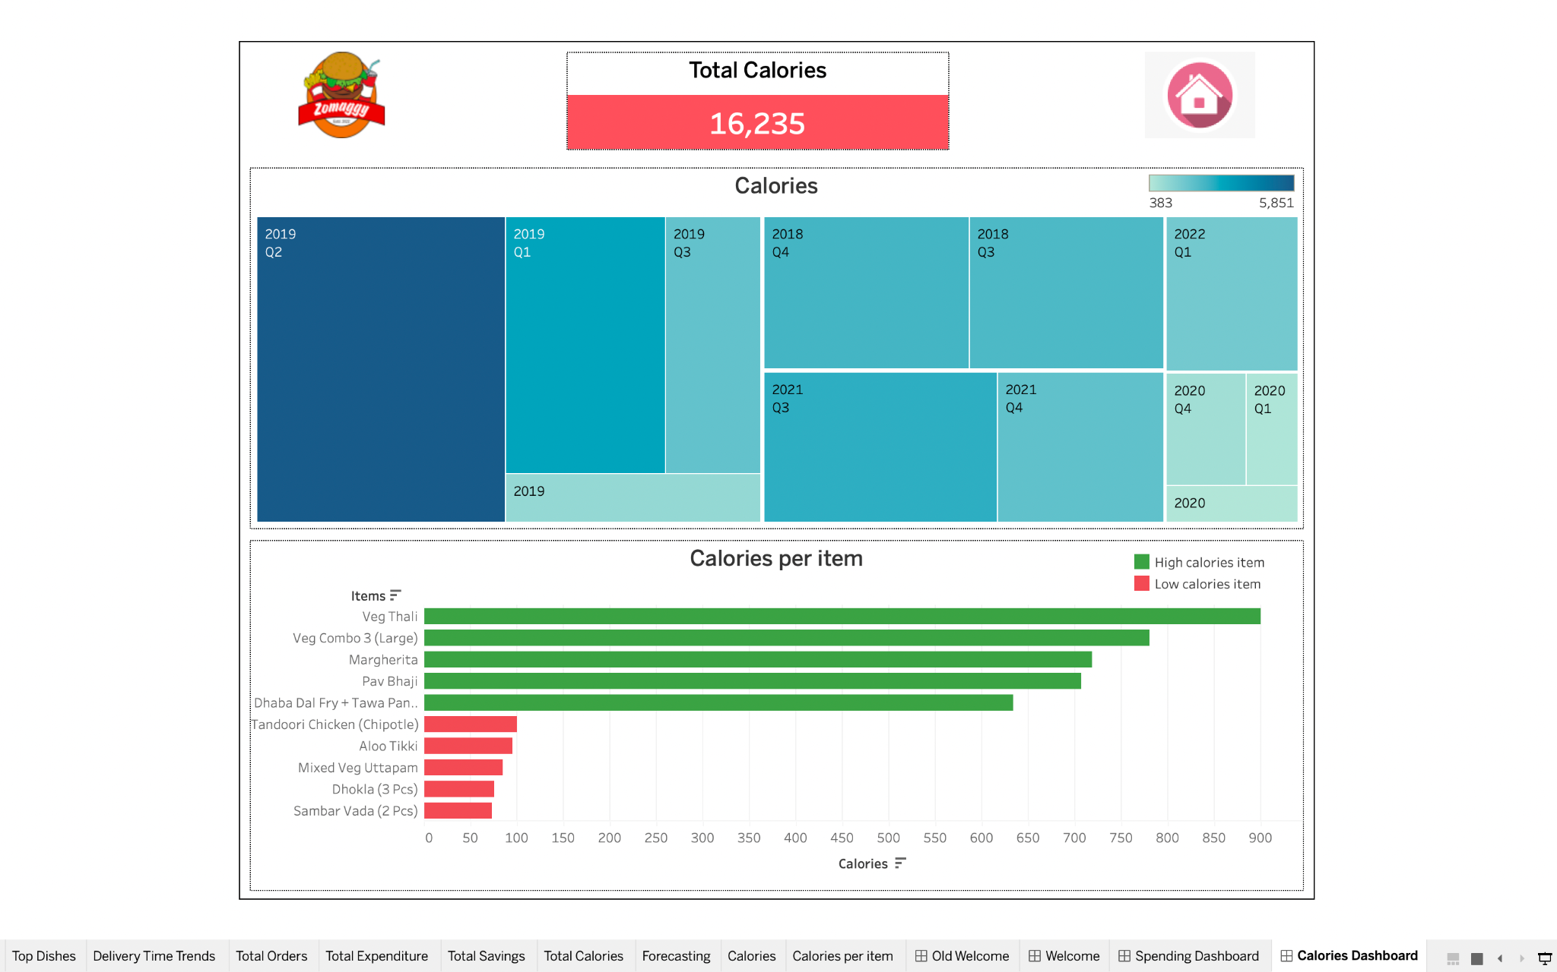

Slide 42


Slide 43

User Dashboard Testing

Slide 44


Slide 45

Zomaggy Dashboard
Notes:
Tableau Demo

Slide 46

Zomaggy Dashboard

Slide 47

Zomaggy Dashboard Testing

Slide 48


Slide 49


Slide 50


Slide 51

Restaurant Dashboard

Slide 52

Testing

Slide 53



Slide 54
Challenges
Data Generation
Integration of Zomaggy application with Snowflake using JDBC connector.
Directly fetching semi structured data query through Workato.
REST API connection of Dataiku with Zomaggy application.
Future Scope
More Optimized analytical solutions for users as well as restaurants.
IOT connection with fitness trackers.
Food ordering and delivery using Zomaggy application.

Slide 55


Slide 56



Project Documentation
Google Drive

Slide 57

Thank you!

